Slide 1
Generalized Linear Mixed Models
EDUC 8825 Advanced Data Analysis
W. Joel Schneider

Slide 2
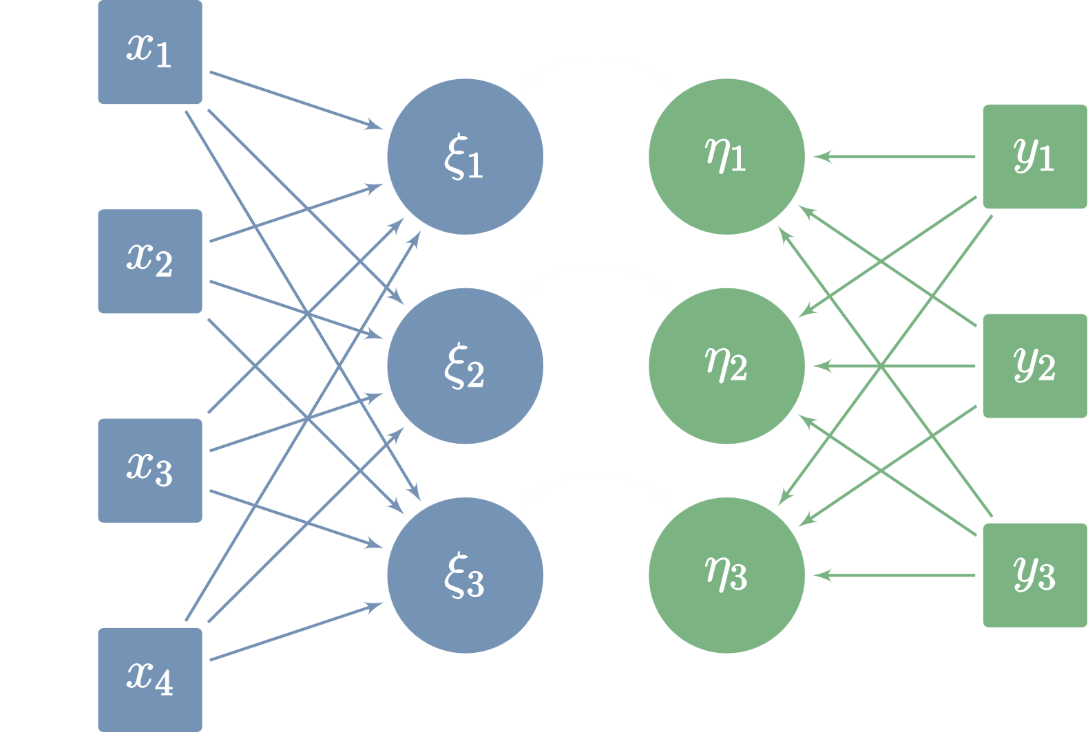
Compare Group Means
Compare | 1 DV | 2+ DVs
Means of 2 groups | t-test | Hotelling’s T²
Multiple group means | ANOVA | MANOVA
Multiple group means, controlling for covariates | ANCOVA | MANCOVA
Discriminant Function Analysis Continuous Variables Predict Categorical Outcome
Canonical Correlation Analysis Relations Among 2 Sets of Variables
Understand Variable Relationships
Predictor | 1 DV | 2+ DVs
Continuous and/or dummy-coded categorical predictors | Multiple Regression | Multivariate Multiple Regression

Slide 3

The General Linear Model
Outcomes
Predictors
Coefficients
Errors

Slide 4
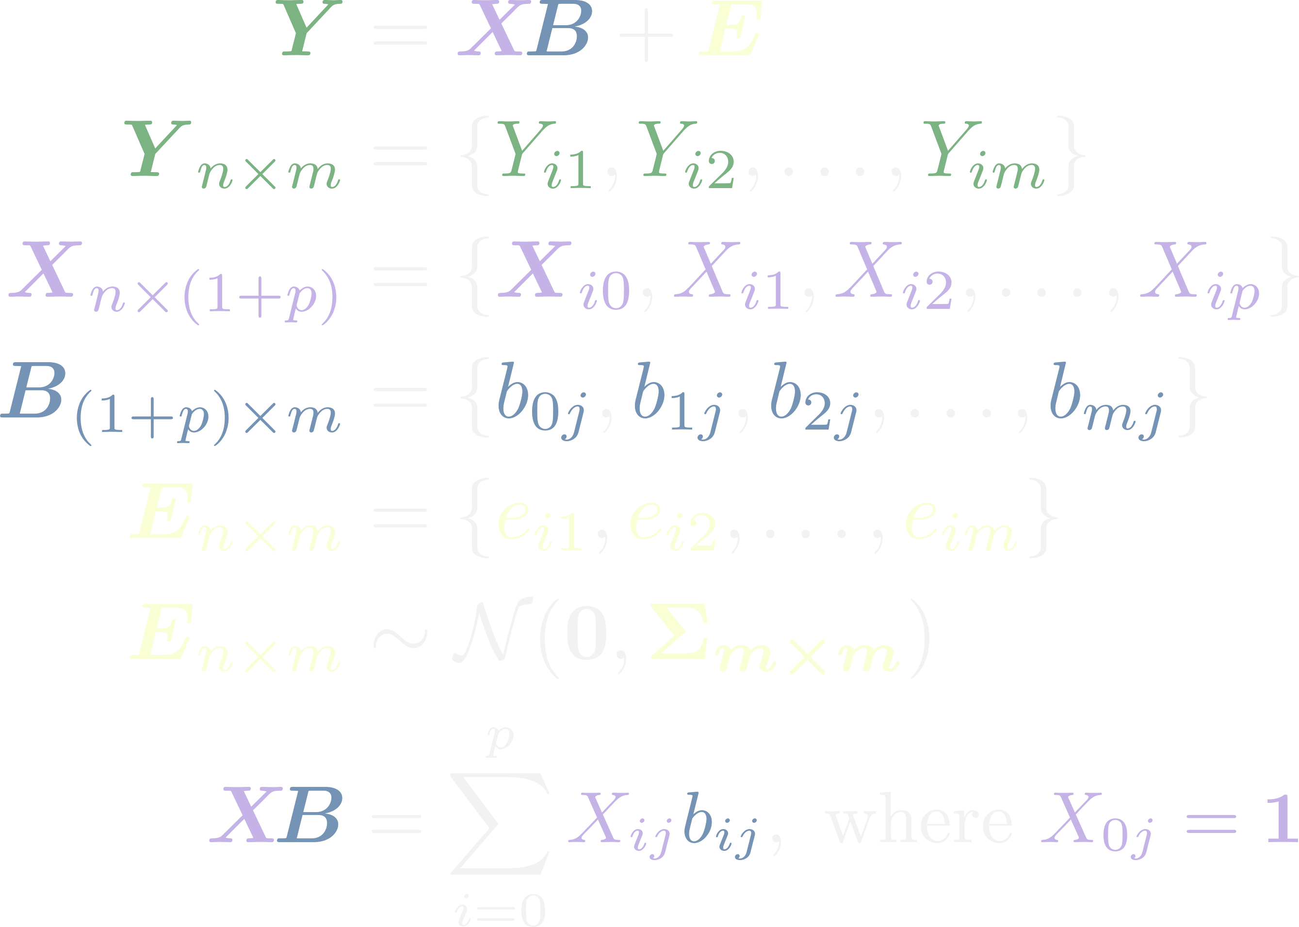
The General Linear Model
Outcomes
Predictors
Coefficients
Errors

Slide 5
Outcomes
Predictors
Predictors
Coefficients
Error
The General Linear Model
Expected Values of Y, Given X

Slide 6

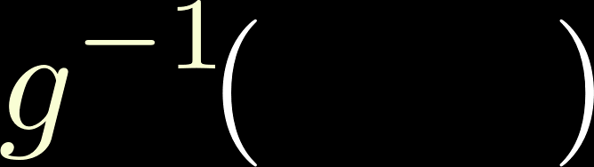
Link Function
Inverse Link Function
The Generalized Linear Model
Outcomes
Predictors
Predictors
Coefficients
Expected Values of Y, Given X

Slide 7

Link Function: Specifies the relation between the response variable (Y) and the linear combination of the predictors (XB)
The Generalized Linear Model
Mean Function = Inverse Link Function
Outcomes
Predictors
Predictors
Coefficients
Expected Values of Y, Given X
Systematic Component
Link Function

Slide 8
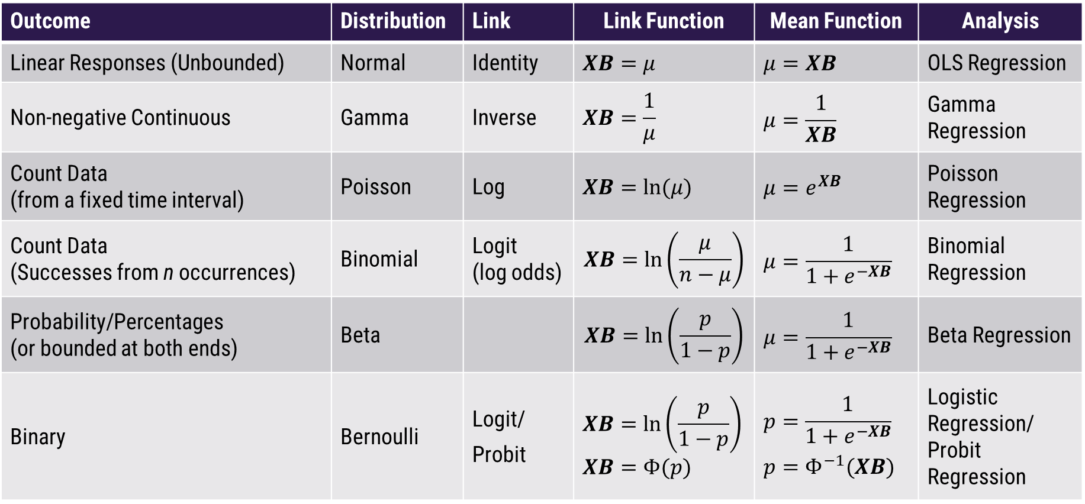
Common Link Functions
Outcome | Distribution | Link | Link Function | Mean Function | Analysis
Linear Responses (Unbounded) | Normal | Identity | $$XB=μ$$ | $$μ=XB$$ | OLS Regression
Non-negative Continuous | Gamma | Inverse | $$XB=\frac{1}{μ}$$ | $$μ=\frac{1}{XB}$$ | Gamma Regression
Count Data (from a fixed time interval) | Poisson | Log | $$XB=ln(μ)$$ | $$μ=e^{XB}$$ | Poisson Regression
Count Data (Successes from n occurrences) | Binomial | Logit (log odds) | $$XB=ln\left(\frac{μ}{n−μ}\right)$$ | $$μ=\frac{1}{1+e^{−XB}}$$ | Binomial Regression
Probability/Percentages (or bounded at both ends) | Beta |  | $$XB=ln\left(\frac{p}{1−p}\right)$$ | $$μ=\frac{1}{1+e^{−XB}}$$ | Beta Regression
Binary | Bernoulli | Logit/ Probit | $$XB=ln\left(\frac{p}{1−p}\right)$$ $$XB=Φ(p)$$ | $$p=\frac{1}{1+e^{−XB}}$$ $$p=Φ^{−1}(XB)$$ | Logistic Regression/ Probit Regression
Poisson regression requires that response mean = response variance. If this strict assumption is not plausible, try negative binomial regression or zero-inflated poisson regression if there are too many 0s.
Notes:
Gamma useful when non-negative outcome is positively skewed (e.g., time between independent events that occur with constant probability). Can be helpful if residuals are hypothesized to be the result of unmeasured factors that are multiplied rather than added.

Slide 9
Ability & Probability
How does a person’s ability relate to the probability the person will answer a specific question correctly?

Slide 10
Probability Problems
p has a uniform distribution from 0 to 1, which is fine for a predictor, but can lead to absurdities for outcome variables. Why? Because OLS regression will often make predictions outside 0 and 1. Such values make no sense.
Convert p to probits or logits solves this problem

Slide 11
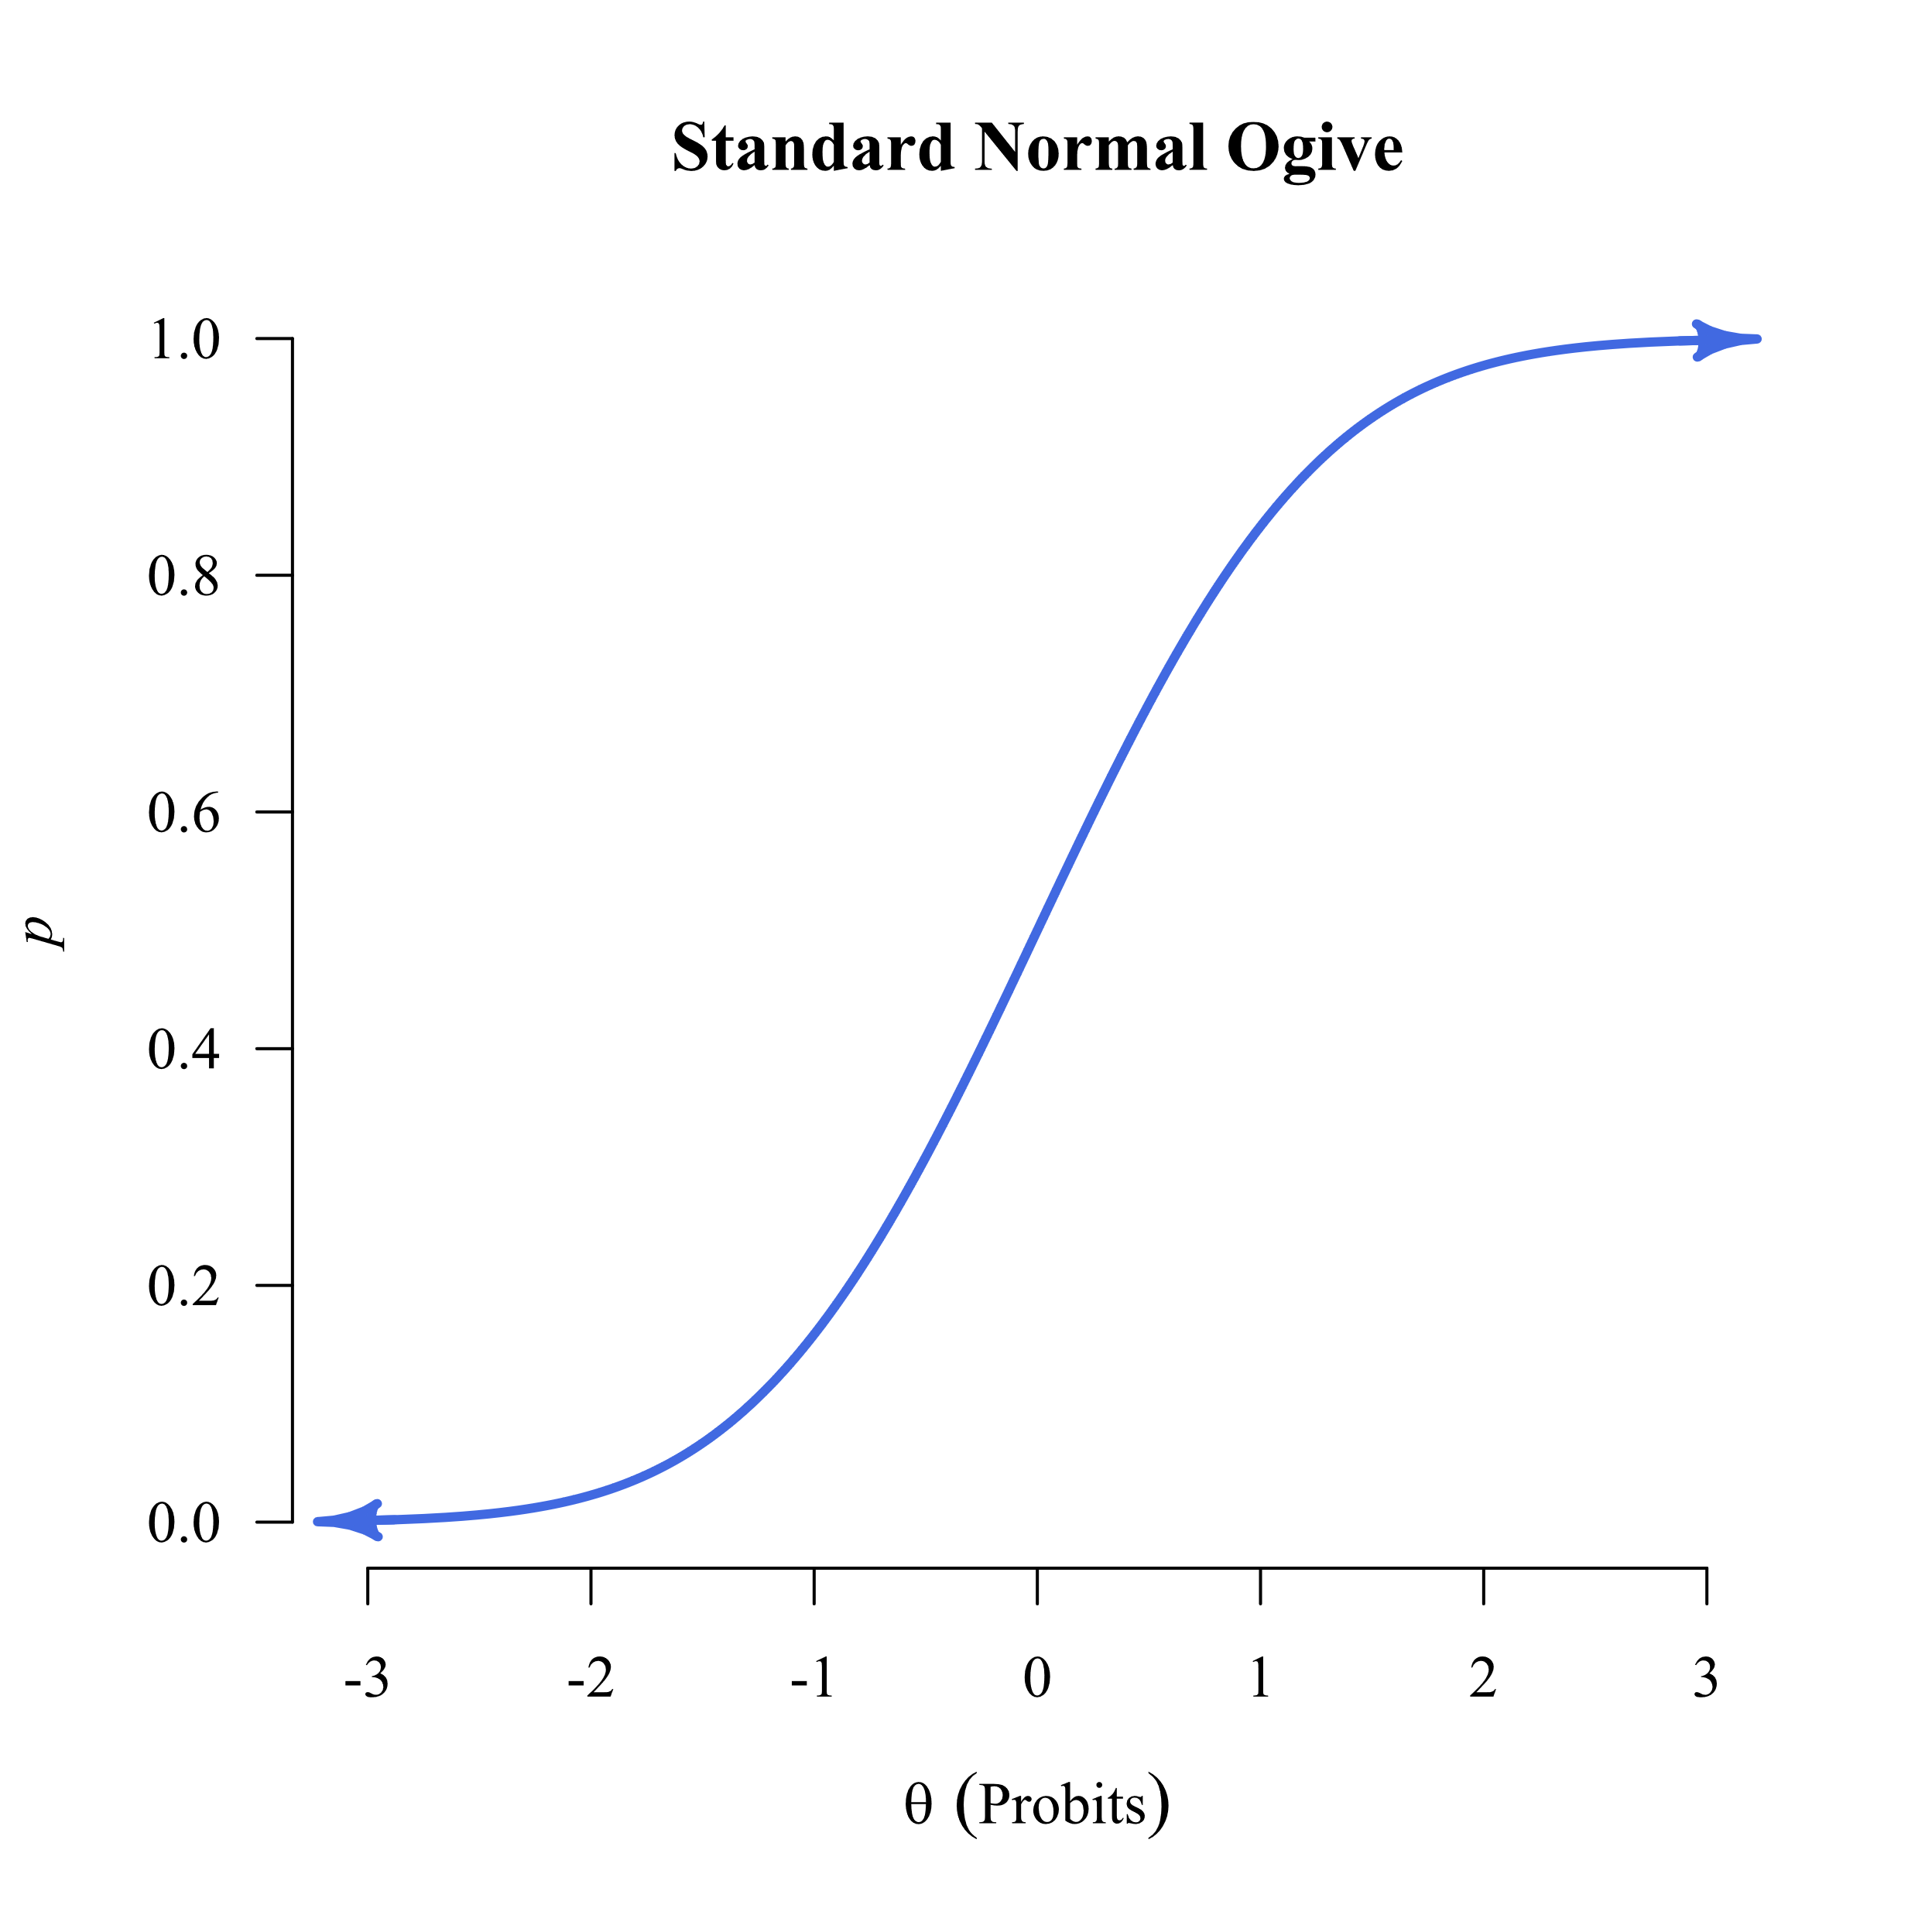
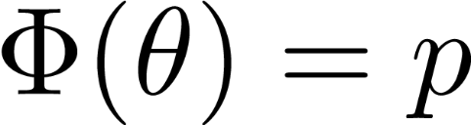
Mapping Ability onto Probability
θ = the ability of a person.
p = the probability that the person will succeed on a test item with a Bernoulli distribution.
Φ() is the cumulative distribution function of the standard normal distribution (μ = 0,σ ² = 1).

Slide 12
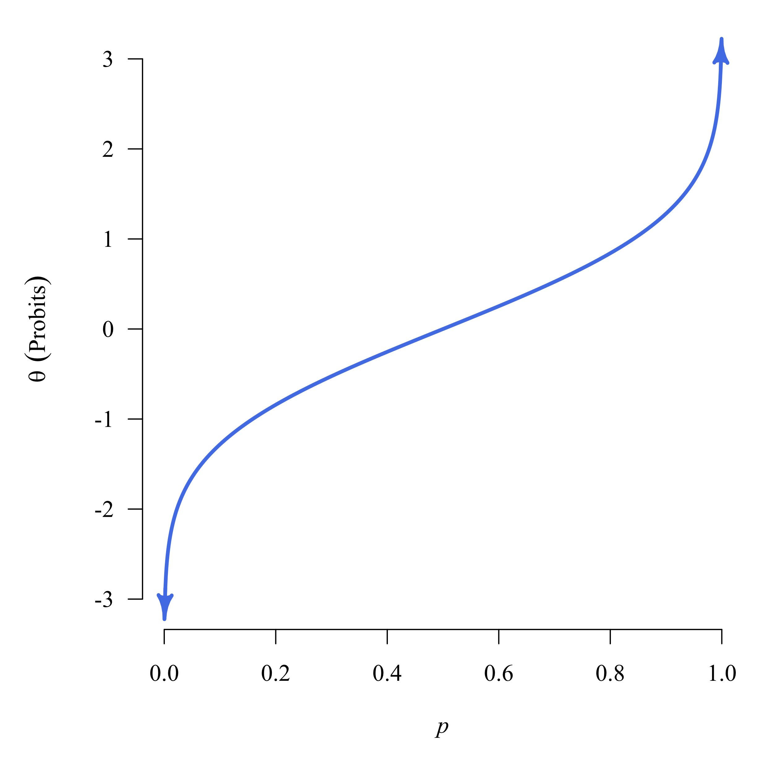
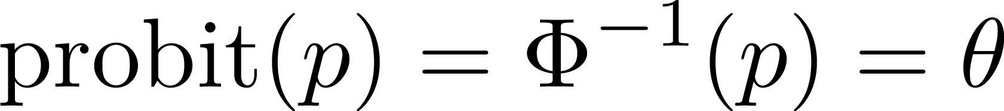
Probit: Standard Normal Quantile Function
The inverse of the CDF is called a quantile function.
The quantile function of the standard normal distribution is the probit function.
The term probit is a portmanteau of probability unit.

Slide 13



logit = log unit
odds ≠ probability
Logit Function
Taking the natural log of odds converts them to logits (AKA “log odds”)
Exponentiating logits converts them back into odds:

Slide 14
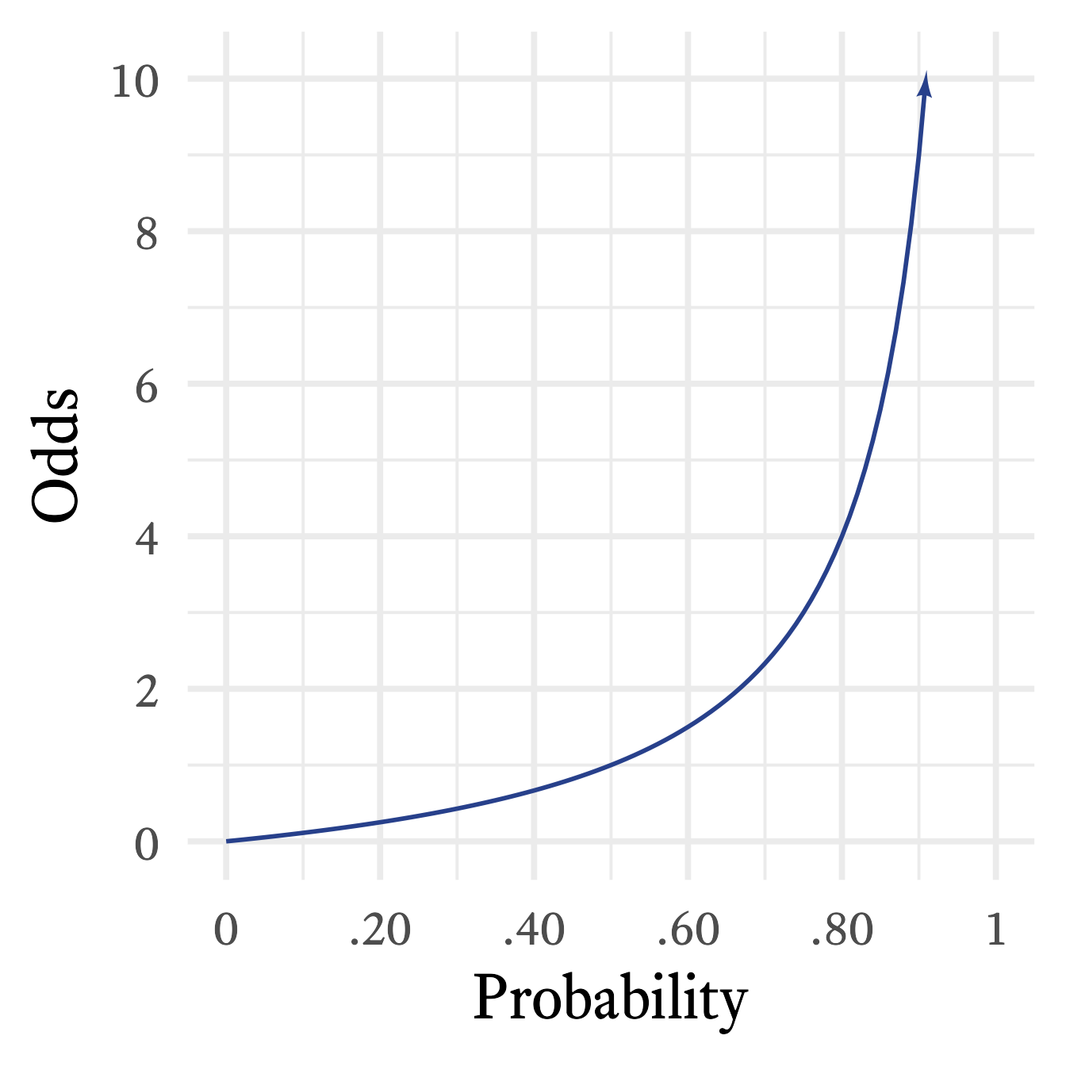
odds ≠ probability

Slide 15
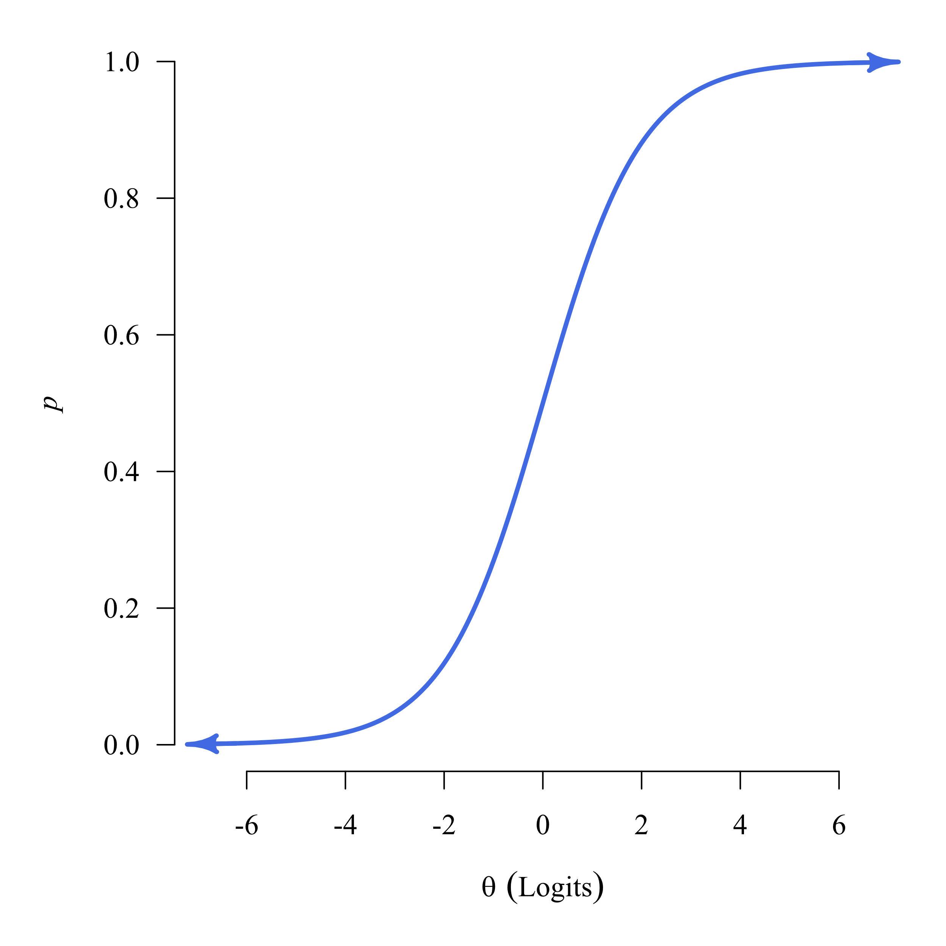
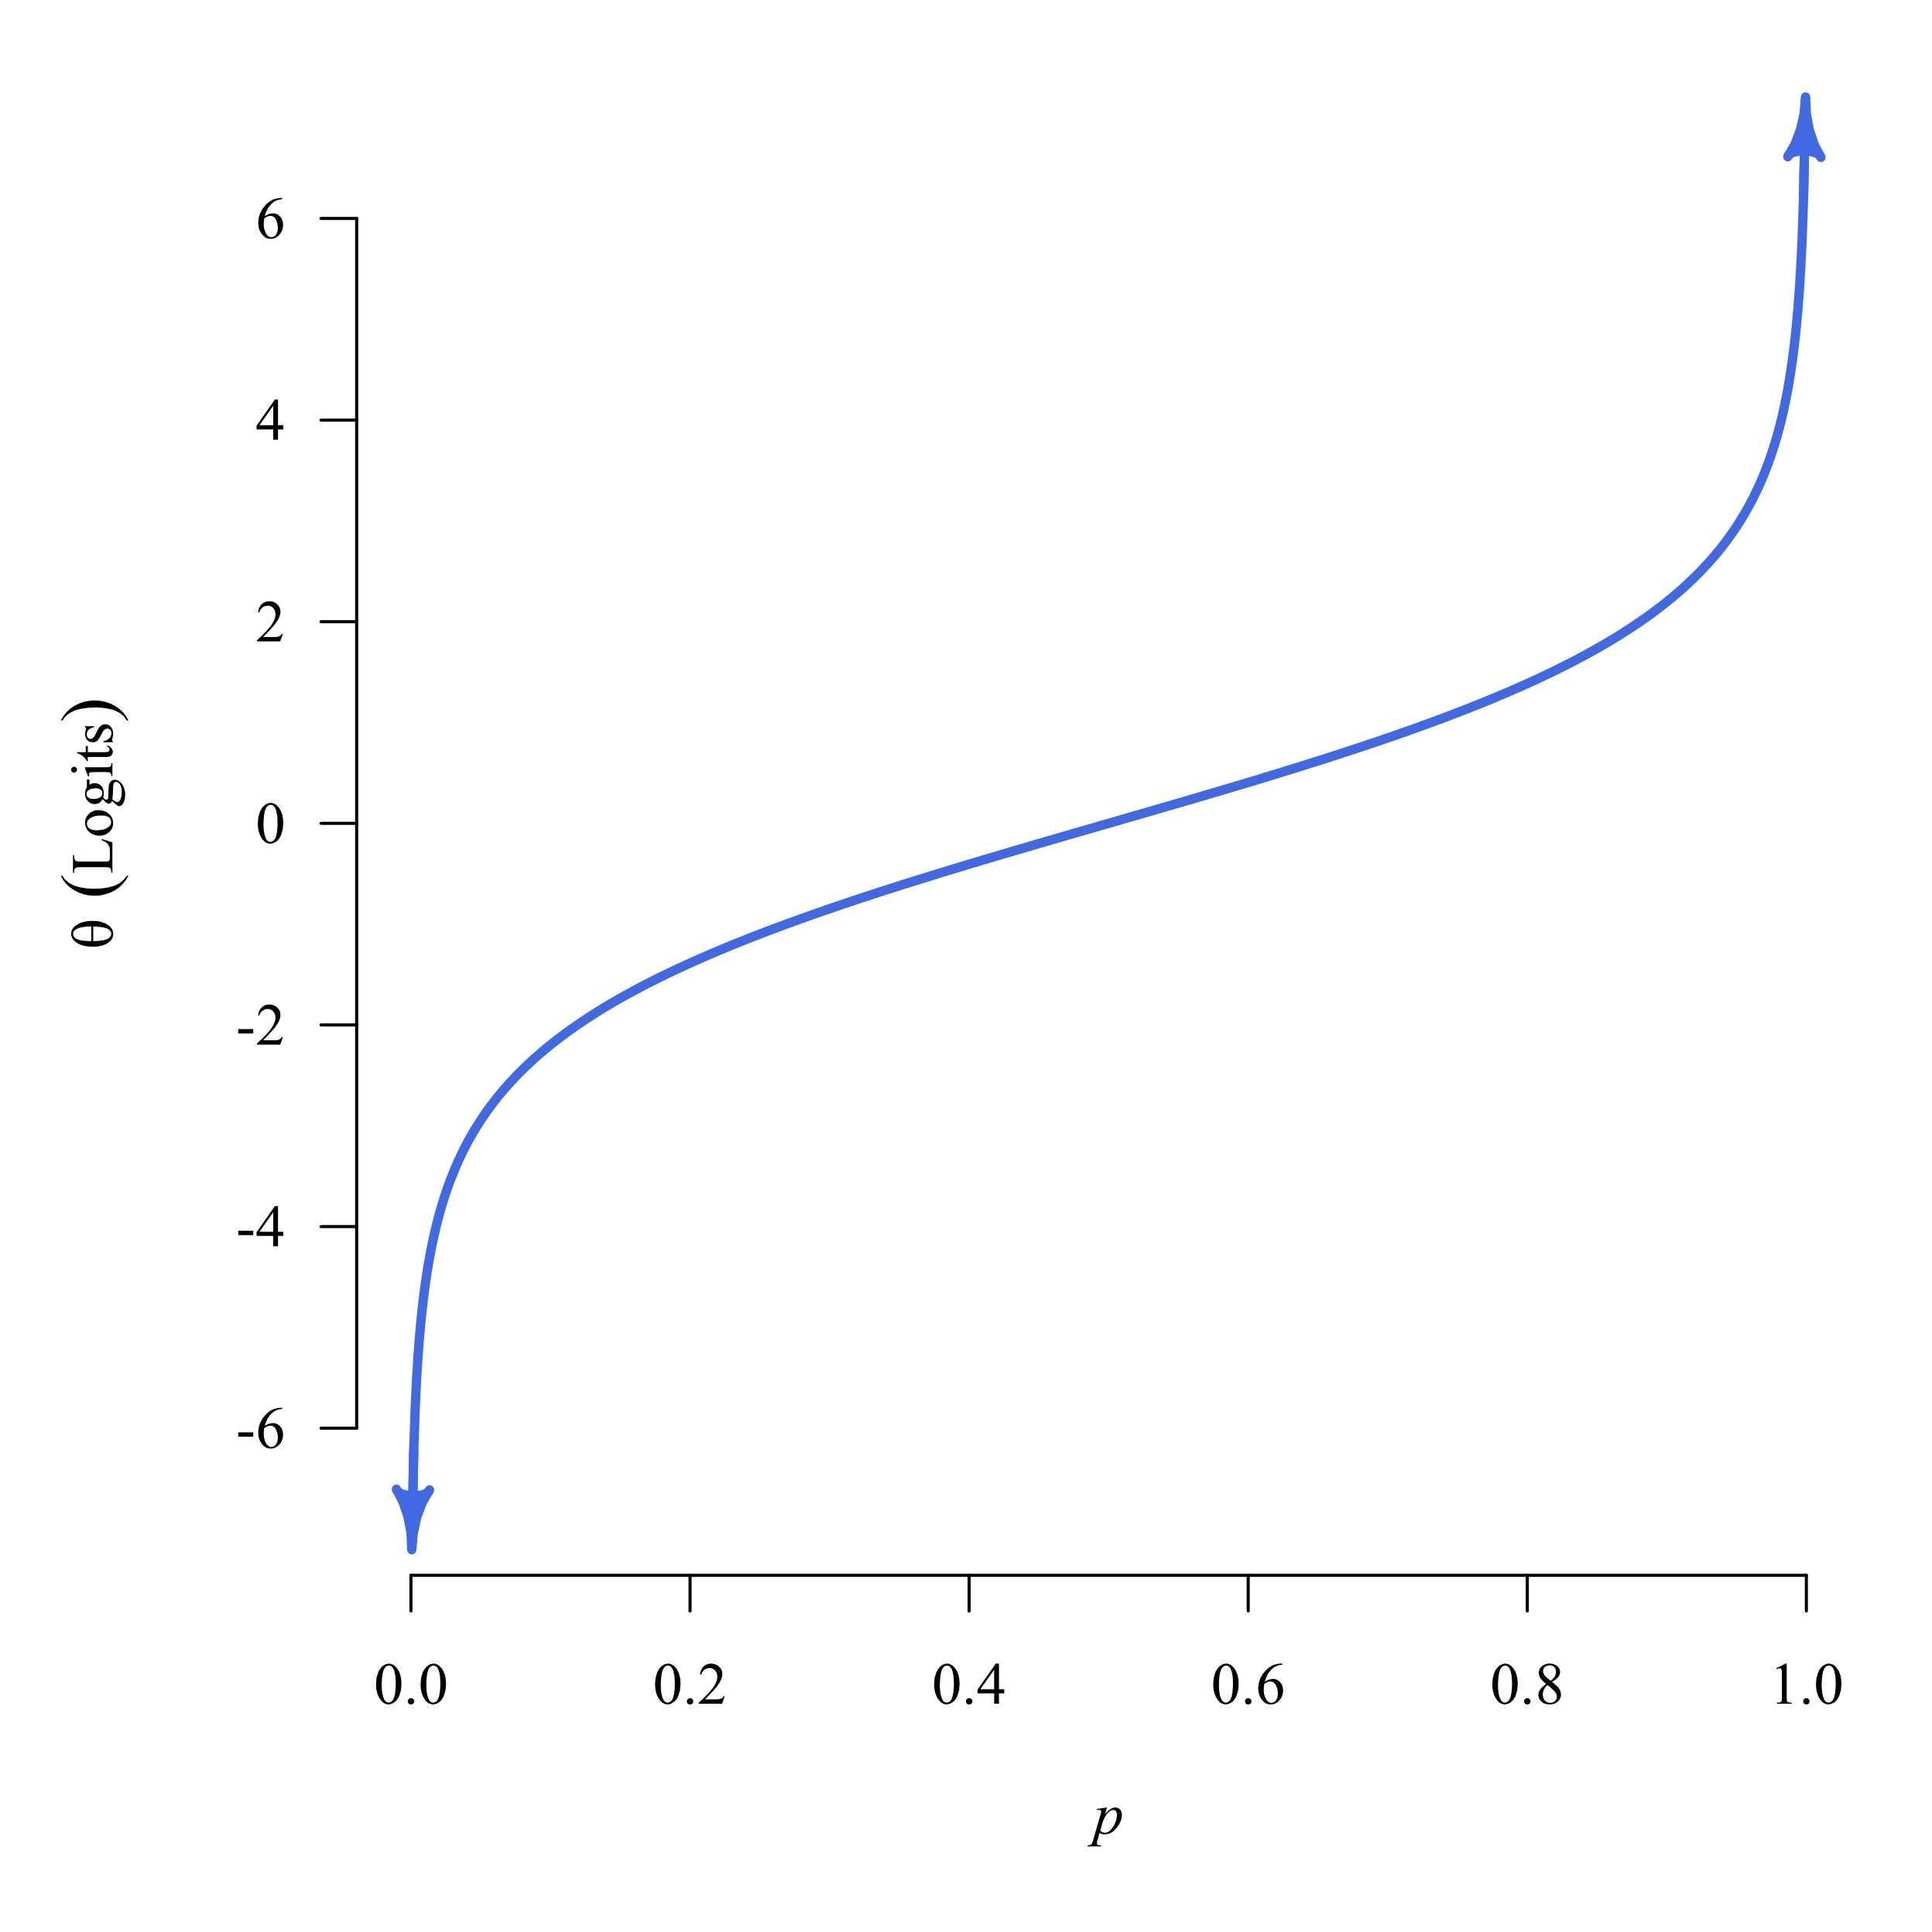
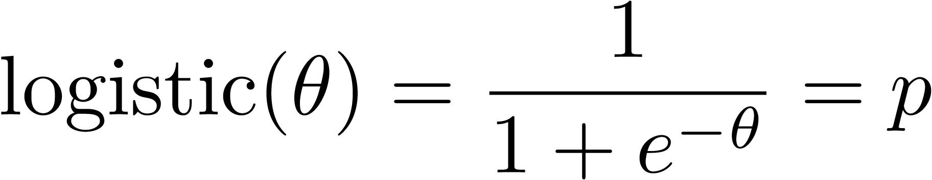
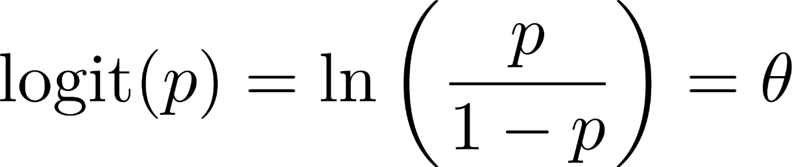
Logistic Function
Logit Function

Slide 16
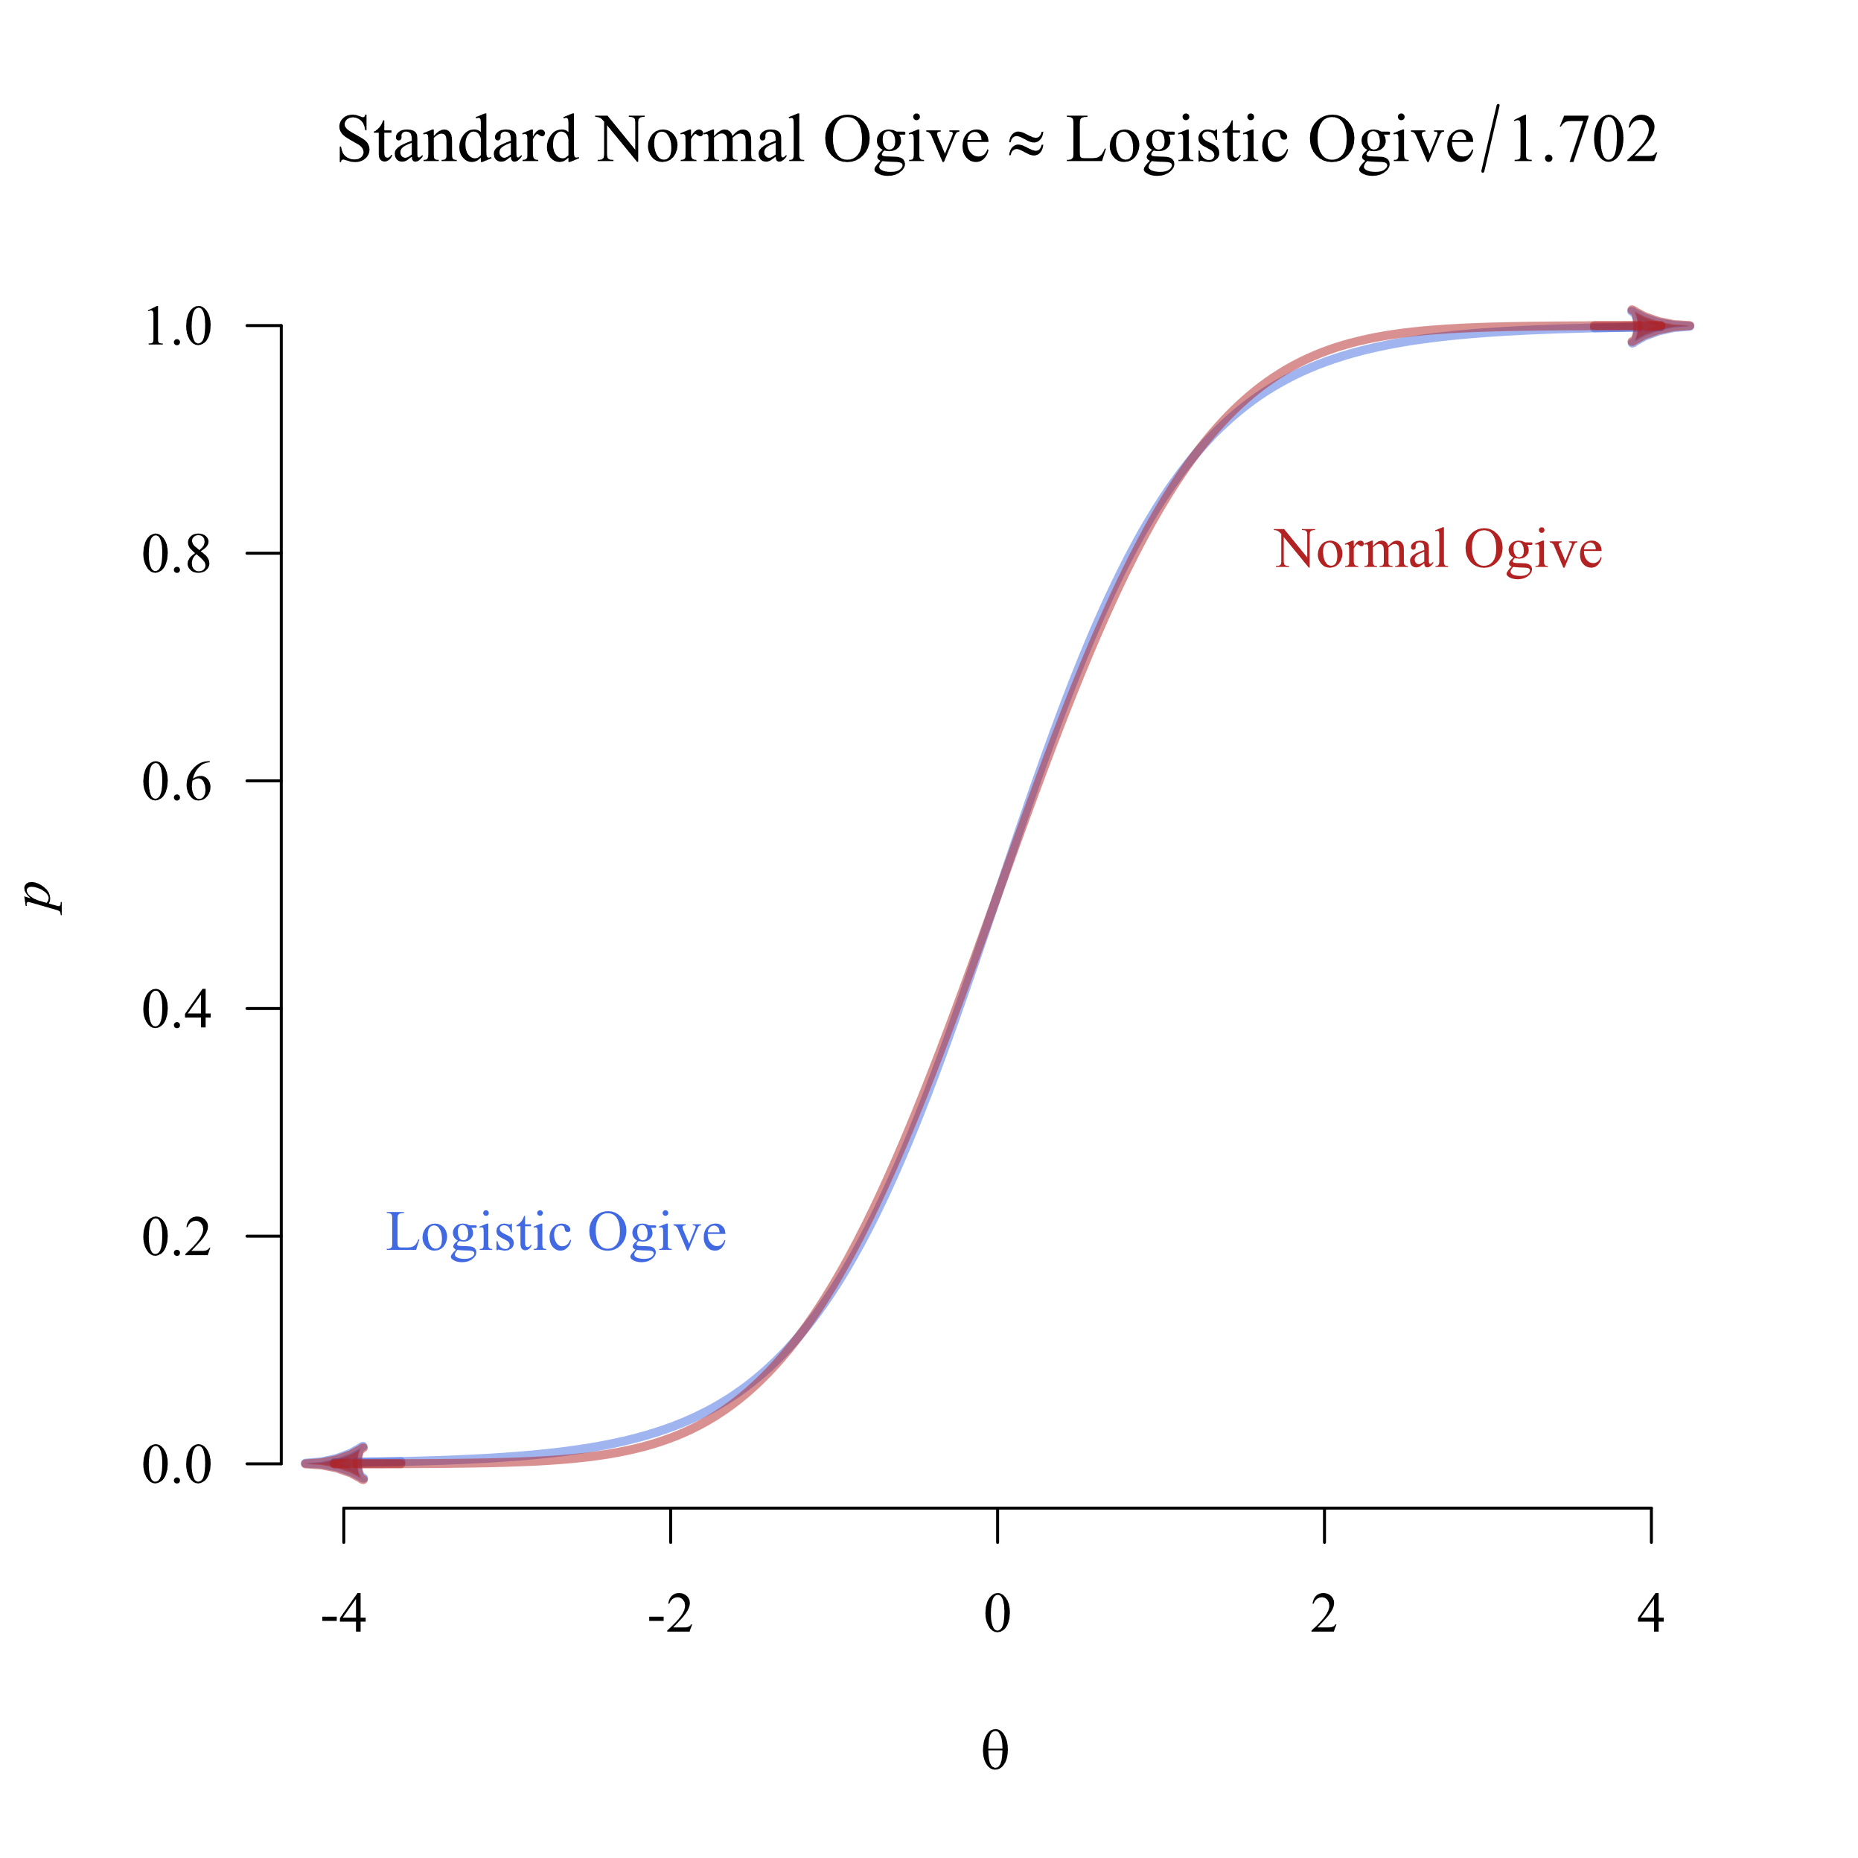
Logits and Probits Are Nearly the Same
Logistic regression is by far the more common. Their results are nearly the same every time. Philosophically, logistic regression is for something that happens, or it does not happen. Probit regression is for something with an underlying normal distribution that triggers an event if a threshold is crossed (e.g., a diagnosis based on a normally distributed trait). When in doubt, use logistic regression.

Slide 17
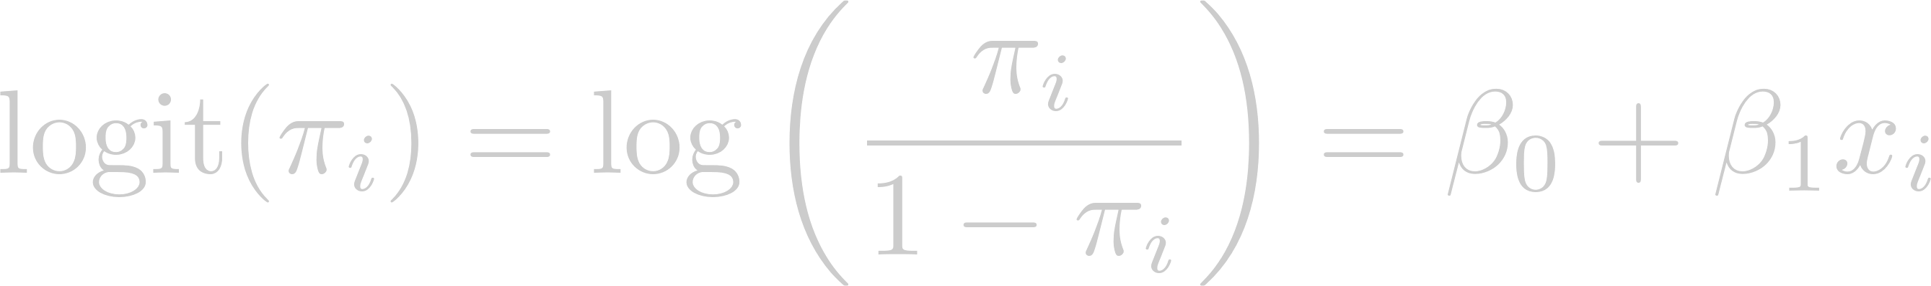
Binary Logistic Regression
Instead of predicting the binary outcome directly, predict the logit (log-odds) of the outcome.

Slide 18
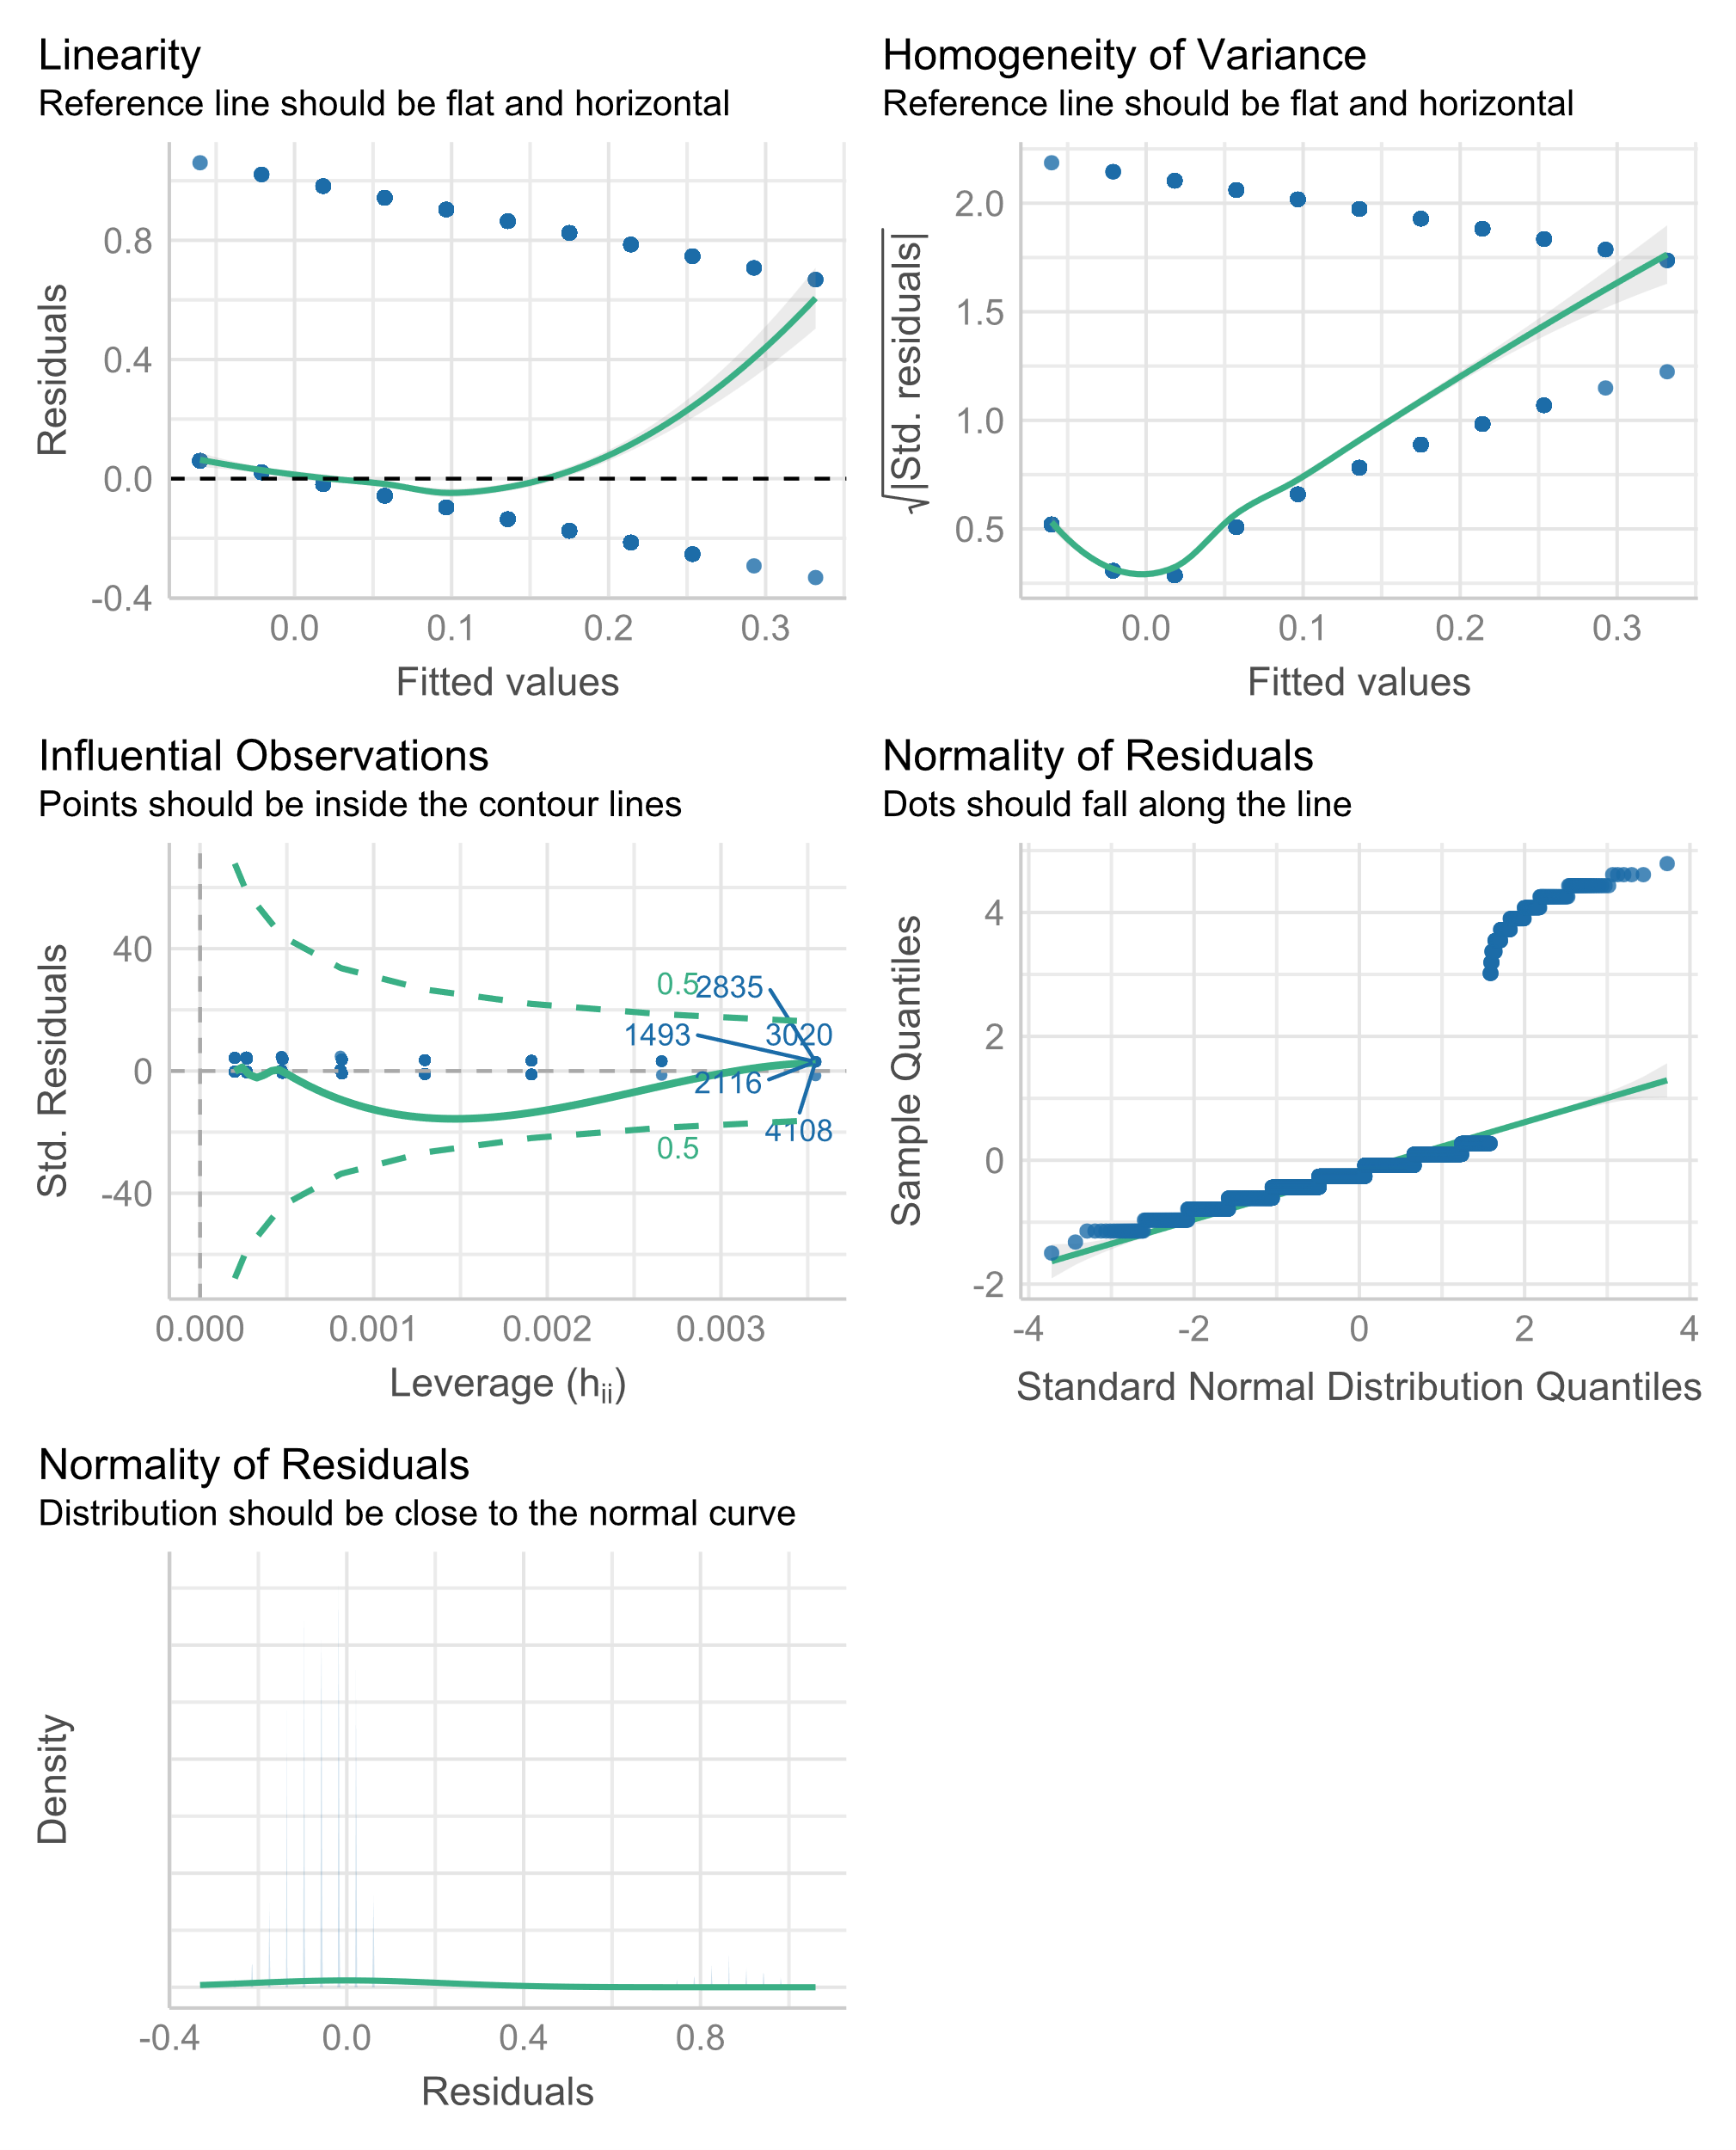
Absences Predict Dropout Probability
Absences Predict Dropout Probability
Incorrect General Linear Model:
lm(Dropout ~ Absences)
Output from
performance::check_model

Slide 19


Slide 20

Interpreting Logistic Regression Coefficients

Slide 21


Interpreting Logistic Regression Coefficients
A slope of 0.66 means that each 1 unit increase in the predictor increases the odds ratio by a factor of 1.94.

Slide 22
Generalized Linear Mixed Models
glmer(Y~X+(1|id))
Generalized Linear Models + Mixed Models
glm(Y~X)
lmer(Y~X+(1|id))

